Slide 1
Bio& 242, Human A&P 2: Unit 1/Lecture 1

Slide 2
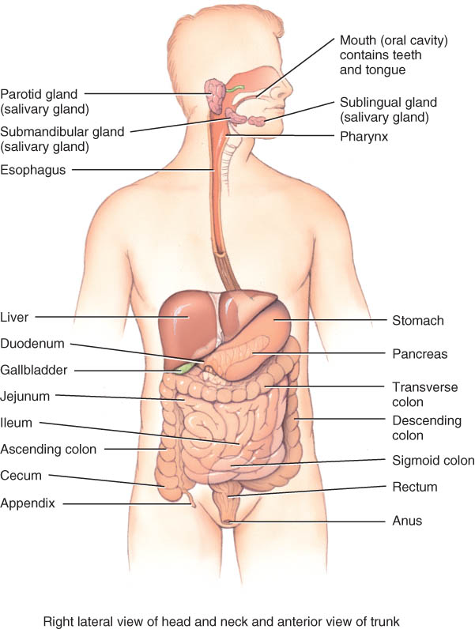
Overview of GI tract Functions
Mouth---bite, chew, swallow
Pharynx and esophagus----transport
Stomach----mechanical digestion; absorption of water & alcohol; chemical digestion
Small intestine--chemical digestion & absorption
Large intestine----absorb electrolytes & vitamins (B and K)
Rectum and anus---defecation

Slide 3
Digestion includes 7 basic processes.
Ingestion: taking food into the mouth (eating).
Secretion: release by cells within the walls of the GI tract and accessory organs of water, acid, buffers, and/or enzymes into the lumen of the tract.
Mixing and propulsion (Peristalsis): result from the alternating contraction and relaxation of the smooth muscles within the walls of the GI tract.
Mechanical digestion: consists of movements of the GI tract that aid chemical digestion.
Chemical digestion: is a series of catabolic (hydrolysis) reactions that break down large carbohydrate, lipid, and protein food molecules into smaller molecules that are usable by body cells.

Slide 4
Digestion includes 7 basic processes.
Absorption: passage of end products of digestion from the GI tract into blood or lymph for distribution to cells.
Defecation: emptying of the rectum, eliminating indigestible substances from the GI tract.

Slide 5
Mouth and it’s associated glands
The mouth (oral or buccal cavity): is formed by the cheeks, hard and soft palate, lips, and tongue.
The vestibule: is bounded externally by the cheeks and lips and internally by the gums and teeth.
The oral cavity proper: is a space that extends from the gums and teeth to the fauces, the opening between the oral cavity and the pharynx or throat.

Slide 6
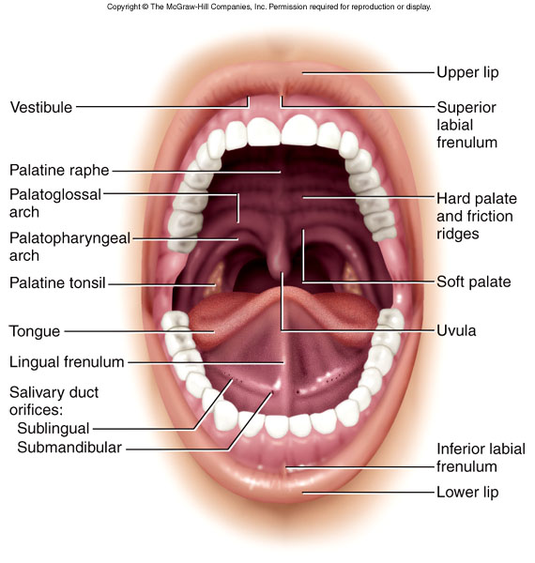
Mouth and it’s associated glands
Lips and cheeks: contains buccinator muscle that keeps food between upper & lower teeth
Vestibule: area between lips and teeth
Oral cavity proper:
roof = hard, soft palate and uvula
floor = the tongue
Sides = teeth and gums
Anterior = teeth and gums

Slide 7
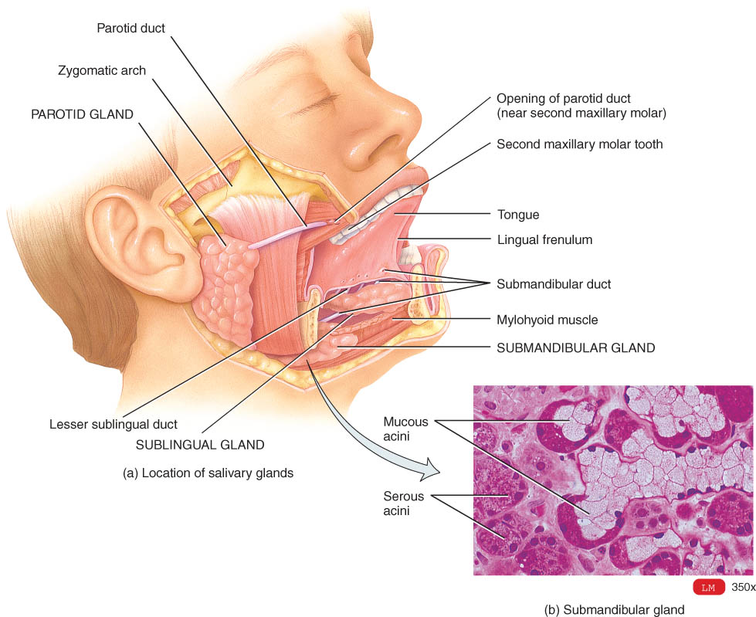
Mouth and it’s associated glands
Mouth: Ingestion
Teeth:
Mastication = Mechanical digestion
Salivary Glands:
Parotid; Stenson's duct
Submandibular; Wharton's duct
Sublingual; Rivinus' duct
Mumps is an inflammation and enlargement of the parotid salivary glands
caused by infection with the mumps virus (myxovirus).
Salivation is entirely under autonomic nervous control via the parasympathetic

Slide 8
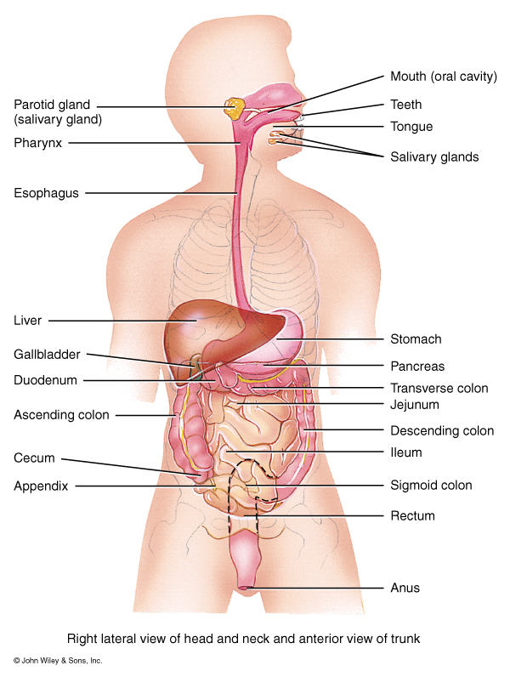
Mouth continued
Salivary Glands:
Water: Moistens Food and dissolves food for tasting
Mucus: Lubricates and binds food into bolus
Amylase: Starts break- down of
Starch and Glycogen
Bicarbonate (HCO3):
Buffering action neutralizes acidic food in the mouth
Enzymes: (lysozymes)
helps destroy bacteria in the mouth

Slide 9
Structure and Function of the Tongue
Tongue: forms the floor of the oral cavity. It is composed of skeletal muscle covered with mucous membrane.
Extrinsic and intrinsic muscles: permit the tongue to be moved to participate in food manipulation for chewing and swallowing and in speech.
Extrinsic muscles: move the tongue, learned in the muscle unit.
Intrinsic Muscles: change the shape of the tongue, some people have a gene mutation the limits the use of these muscles
Lingual frenulum: fold of mucous membrane that attaches to the midline of the undersurface of the tongue.
Children born with to pronounced frenulum are tongue tied
Papillae: cover upper surface and sides of the tongue.
lingual lipase: Enzyme produced by glands on the dorsum of the tongue. initiates digestion of triglycerides.

Slide 10
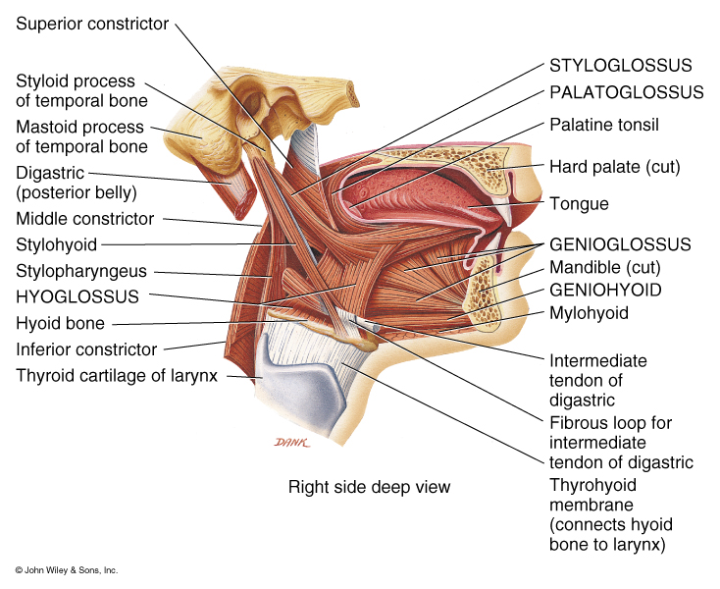
Structure and Function of the Tongue
Muscles of tongue are attached to hyoid, mandible, hard palate and styloid process
Papillae: elevations that create a rough surface for manipulating food and providing sensations
Filiform: temperature, touch, and pressure sensations
Fungiform: taste buds
Foliate: taste buds
Circumvallate: taste buds

Slide 11
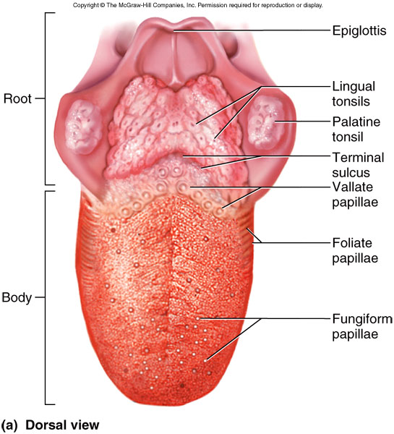
Structure and Function of the Tongue

Slide 12
Structure and Function of the Teeth
Teeth: project into the mouth and are adapted for mechanical digestion
Tooth principal portions: crown, root, and neck.
Tooth composition:
dentin, a calcified connective tissue that gives the tooth its basic shape and rigidity
enamel, covers dentin and protects the tooth from the wear of chewing.
cementum, covers dentin of the root and is a bone-like substance,
periodontal ligaments, attaches root to the alveolar process pulp cavity: space in the crown and the root canals in the root.

Slide 13
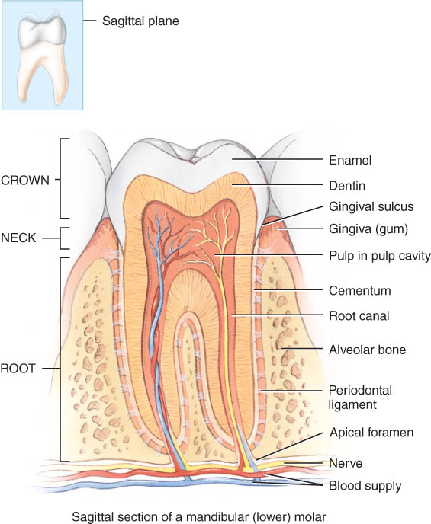
Composition of Teeth
Enamel
hardest substance in body
calcium phosphate or carbonate
Dentin
calcified connective tissue
Cementum
bone-like
periodontal ligament penetrates it

Slide 14
Dentition
There are two sets of teeth or dentition:
deciduous (primary), milk teeth, or baby teeth permanent (secondary) Adult or permanent teeth
Primary or baby teeth
20 teeth that start erupting at 6 months
1 new pair of teeth per month
Consisting of incisors, canines, and molars
Permanent teeth
32 teeth that erupt between 6 and 12 years of age replacing primary teeth
Consisting of incisors, canines, premolars and molars

Slide 15
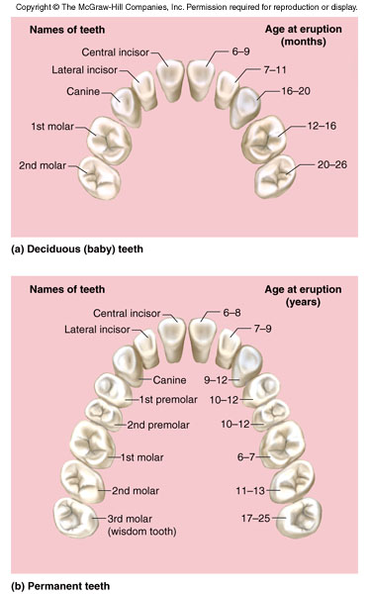
Dentition
Differing structures of teeth indicate function
Incisors: biting teeth
4 upper and 4 lower
Canines or “cuspids”: tearing teeth
2 upper and 2 lower
Premolars or “bicuspids”: crushing and grinding teeth
4 upper and 4 lower
lacking in primary teeth
Molars or “tricuspids”: crushing and grinding teeth
3 upper and 3 lower
3rd molars are “wisdom” teeth

Slide 16
PHARYNX
Pharynx: funnel-shaped tube that extends from the internal nares to the esophagus posteriorly and the larynx anteriorly. Moves bolus of food
It is composed of skeletal muscle and lined by mucous membrane.
Divide into three regions
Nasopharynx: functions in respiration only,
oropharynx: Functions in both respiration and digestion. Located between the naso and laryngopharynx and posterior to oral cavity.
laryngopharynx Functions in both respiration and digestion. Located inferior to oropharynx.
Two Arches
Platatoglossal: anterior most arch
Platatopharyngeal: posterior most arch
Platatine tonsils sit between these arches.

Slide 17
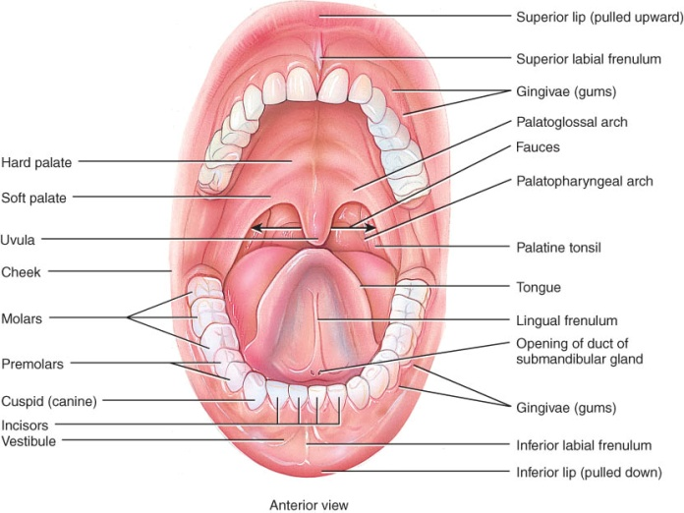

Slide 18
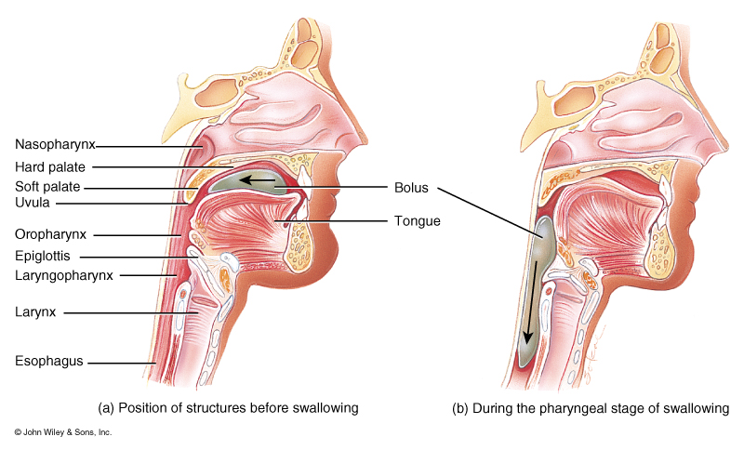
Deglutition or swallowing
starts when bolus is pushed into the oropharynx
sensory nerves send signals to deglutition center in brainstem
soft palate is lifted to close nasopharynx
larynx is lifted as epiglottis is bent to cover glottis

Slide 19
Stages of Deglutition
Voluntary Stage:
a. Buccal or Oral activity
formation and movement of the bolus

Slide 20
Stages of Deglutition
Pharyngeal Stage:
involuntary
Soft-palate is pulled upward closing off the nasopharynx
Palatoglossal and palatopharyngeal arches are pulled medially forming a sagittal slit with the fauces.

Slide 21
Stages of Deglutition
Pharyngeal Stage:
Vocal cords close
Epiglottis swings backward over larynx and larynx is pulled upward to close off the opening of the larynx
Upper esophageal sphincter relaxes to that bolus can enter the esophagus.

Slide 22
Stages of Deglutition
Esophageal Stage: involuntary
Esophagus: Moves bolus from pharynx to the stomach
Peristalsis pushes the bolus downward through the esophagus.
Lower esophageal sphincter relaxes and the bolus enters the stomach

Slide 23
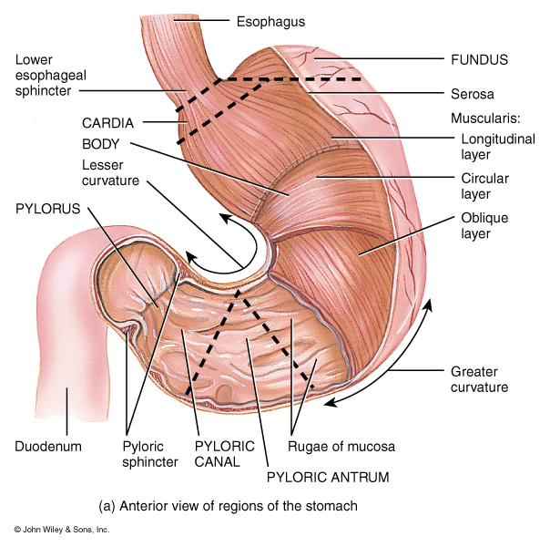
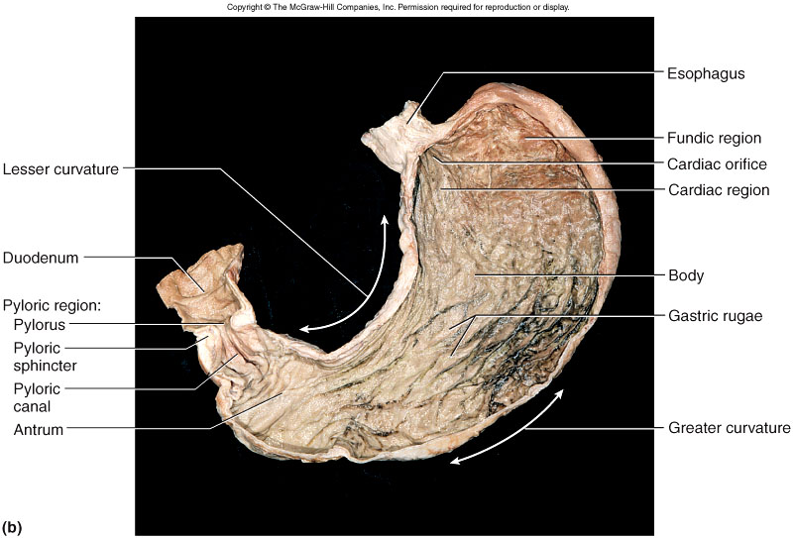
GI Tract Structures: Stomach

Slide 24
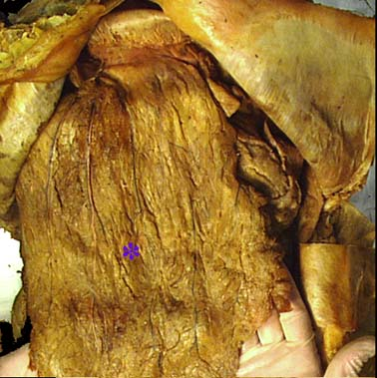
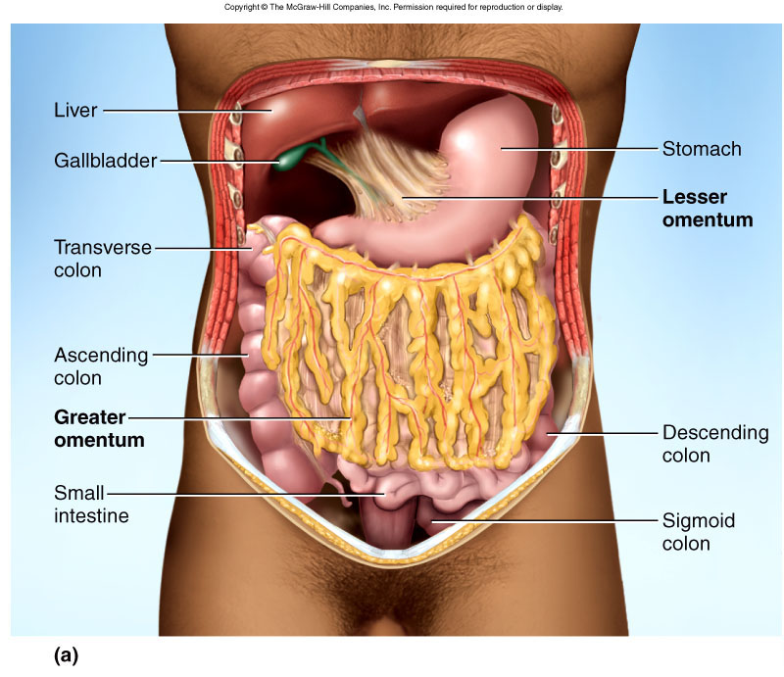
GI Tract Functions: Stomach
Stomach: Stores, mixes, and dissolves food, converts food into chyme, regulates emptying of chyme into small intestines

Slide 25
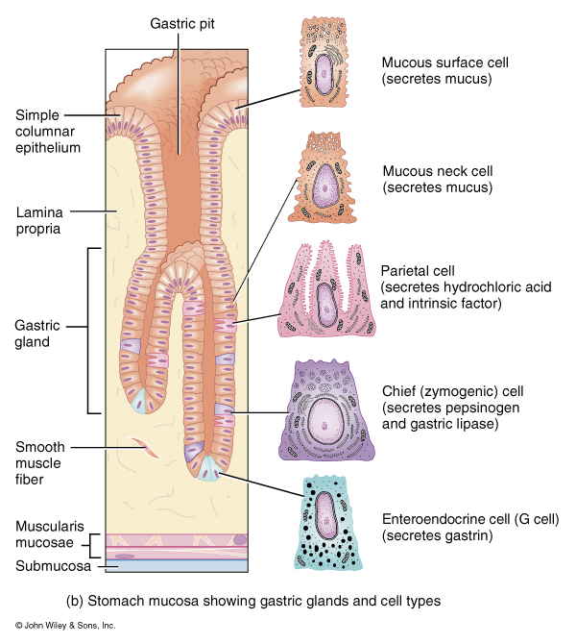
GI Tract Functions: Stomach
Stomach continued:
Mucus: lubricates and protects the stomach mucosa
Hydrochloric acid: dissolves food particles and kills most microorganisms
Pepsinogen: inactive form of the enzyme pepsin. It is activated by HCl. Splits apart peptide bonds to begin the digestion of proteins

Slide 26
GI Tract Functions: Stomach
Stomach continued:
4. intrinsic factor: required for the absorption of vitamin B12
5. Gastrin: hormone that controls HCl release along with other activities to be discussed later

Slide 27
GI tract functions: Small Intestine
Small Intestine:
Segmentation: mixes chyme with digestive juices (from small intestine, pancreas, and liver) and brings chyme into contact with the mucosa for absorption, peristalsis propels chyme toward the large intestine.

Slide 28
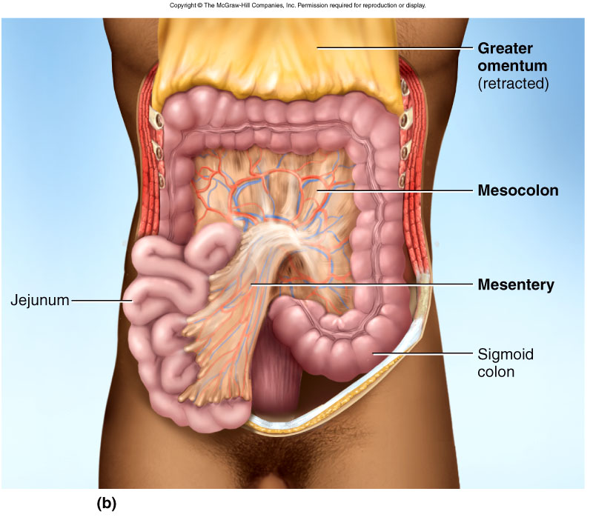
GI tract functions: Small Intestine

Slide 29
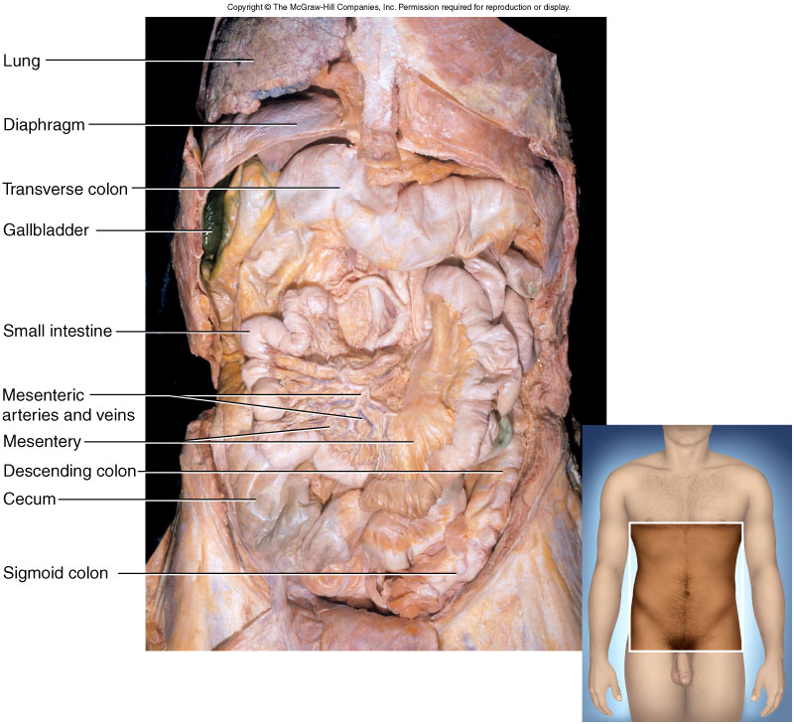
GI tract functions: Small Intestine

Slide 30
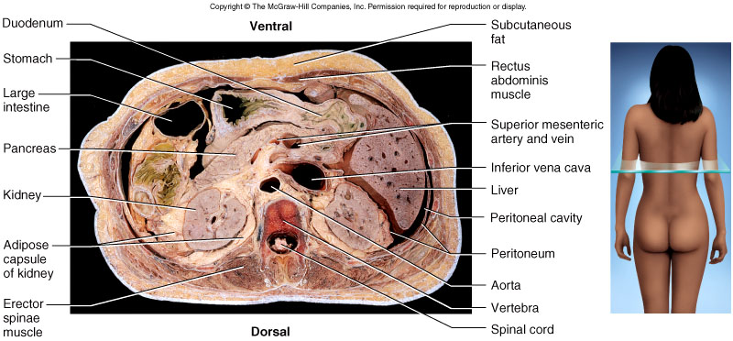
GI tract functions: Small Intestine

Slide 31
GI tract functions: Small Intestine
Small Intestine:
Duodenum: shortest region, about 25cm.
Continues the digestion of carbohydrates, proteins, and lipids. Begins the digestion
of nucleic acids.
Receives the digestive fluids from the pancreas and liver via the hepatopancreatic ampulla.

Slide 32
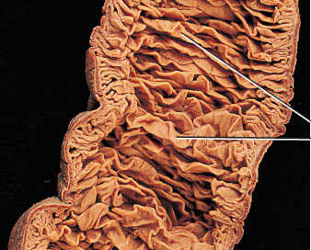
GI Tract Functions : Small Intestine
Small Intestine:
Jejunum: Middle region of the small intestine, about 1 m (3 to 4 ft)
(8 ft in a cadaver due to smooth muscle relaxation)
Completes the digestion of carbohydrates, proteins, lipids, and nucleic acids
Ileum: final and longest region of the small intestine, about 2m (6 ft).
(12 feet in a cadaver)
Involved in absorption of about 90% of the nutrients produced by digestion.

Slide 33
Functions of the Small Intestinal Mucosa
Mucus: lubricates chyme and protects mucosa
Assorted enzymes:
a. pancreatic enzymes
b. brush-border enzymes
(details later)
Secretin: stimulates pancreatic bicarbonate
secretion.
Cholecystokinin:
stimulates gallbladder contraction, pancreatic
enzyme secretion, and
stomach emptying

Slide 34
Functions of the Small Intestinal Mucosa
4. Gastric-inhibitory peptide: inhibits stomach acid secretion and motility

Slide 35
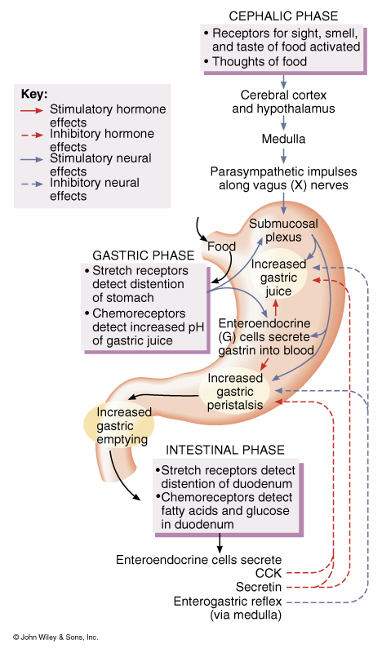
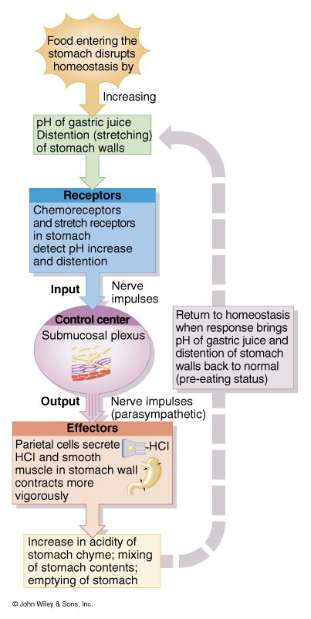

Slide 36
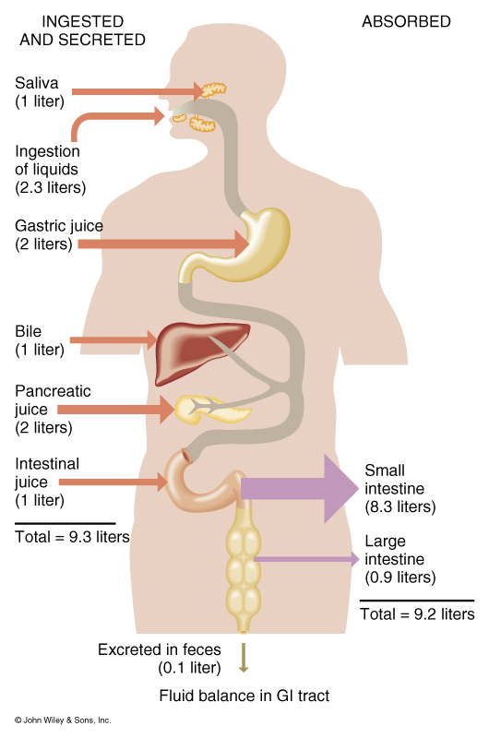
Overview of fluid intake and secretion compared to fluid absorption by the digestive tract

